Slide 1
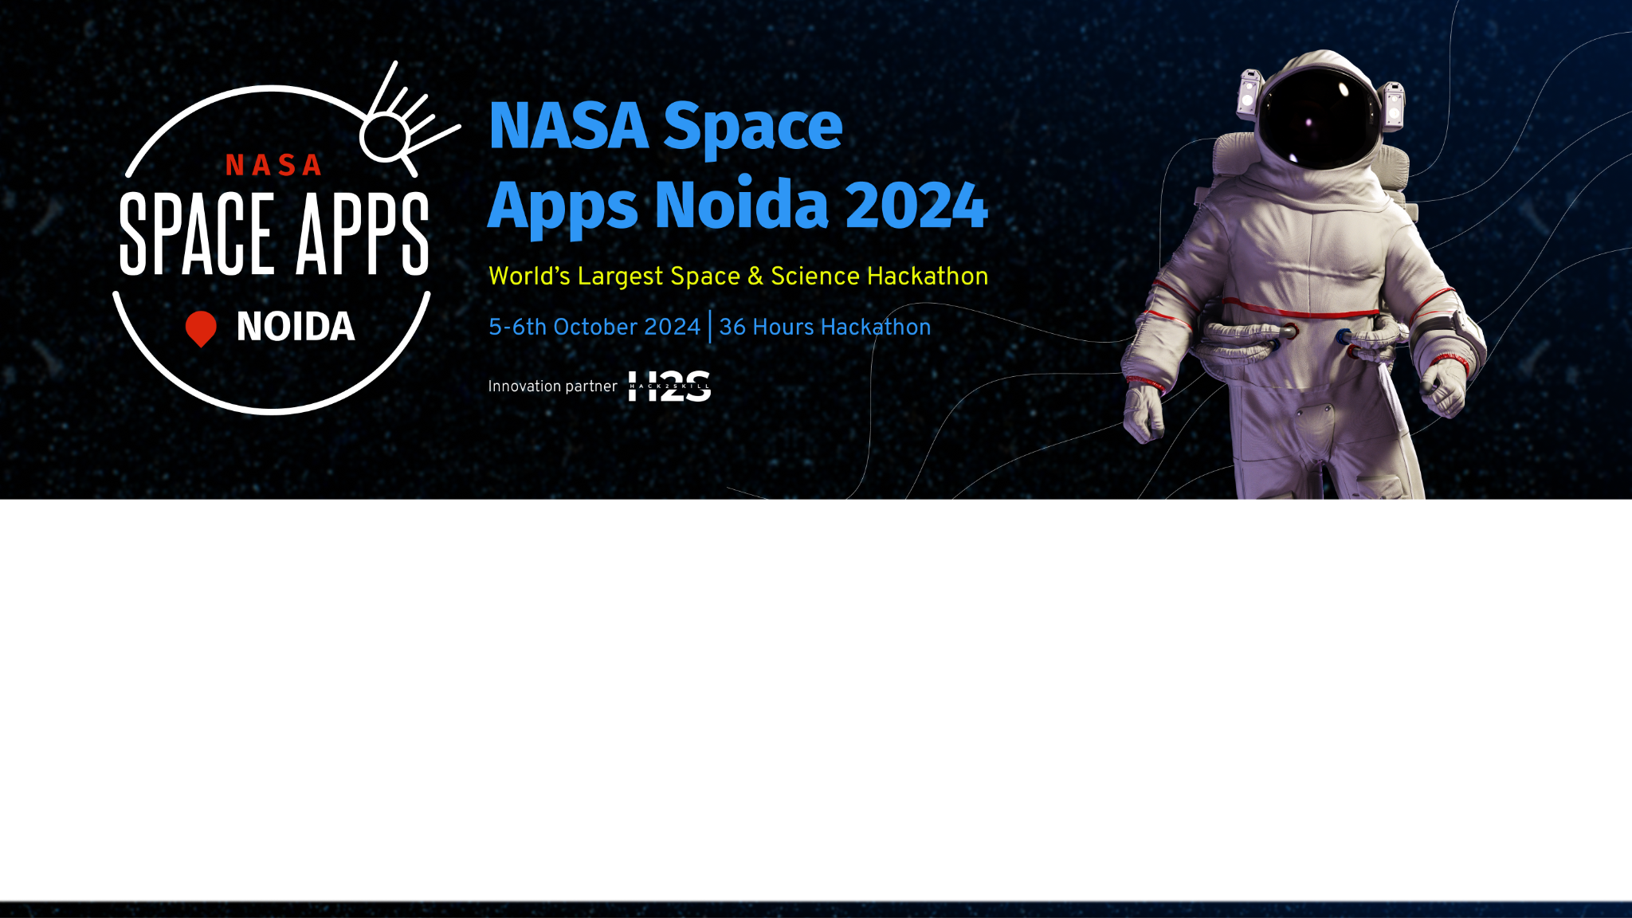
Team Details :
Team name: Tech Grades
Team leader name: Bhaskar Raj
Problem Statement: PACE IN THE CLASSROOM

Slide 2
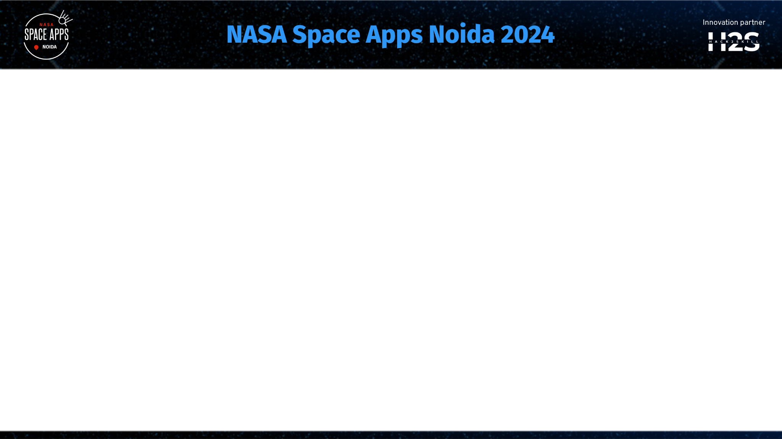
Brief about the idea :
The brief about our idea is that we are creating a website or an publically accessible app of set of info about pace which can be helpful for students across the world.
To make the sophisticated data collected by NASA’s PACE satellite accessible and comprehensible to students.
Simplifies complex information, allowing students to engage with and understand important environmental data.

Slide 3
UNIQUE IDENTIFICATION :
Unlike generic educational tools,this approach leverages real time satellite data,offering students direct access to the scientific research and technology.Provides us with the Hands-on-Learning experience.
Solution to the problem :
In this we are going to integrate complex data of the PACE satellite into a simpler form with the help of advanced technologies and by creating a user-friendly interface.
Unique selling proposition :
Empowering students with embracing technologies and real world applications to deepen understanding of climate science and hands-on ocean literacy education.

Slide 4
Aspects of the solution:
Educational content :
Incorporates up-to-date PACE satellite data , accurate information for high school students and
public in a effective and user-friendly manner.
Resource library :
Provide the data that can be downloaded and stored in a bulk for engagement with normal
public.
Discussion form :
Used to collect data from the user and also it help us with feedbacks and real time data from
different generic applications.

Slide 5
Process flow diagram or Use-case diagram
Start
Homepage
Select
Section
Calculation materials
Data Exploration
About Pace
Viewing
Devlopment ideas
Research Guide
Quizes

Slide 6
Resoource library
Contact Info
Feedback
END

Slide 7
Architecture :
Home page
Satellite details
Interactive Dashboard
Education Materials
Satellite complex data, reports
Ocean Report , data
-research
Activities
-worksheets , guides
Teacher resources
-Guide , study materials
Assesment and Feedback
-quizzes , Feedback Forms
Contact Information
Students

Slide 8
Technologies :
Front end :
Html : For making skeleton of websites.
Css : For styling the website.
Java Script : For giving specific positions.
Back end :
Note js : For real time data handling.
Python : Handle large datasets generated by pace sattelites.
Restful APIs : can provide the structured data.
Data management :
My Sql : For handling unstructured user data.

Slide 9
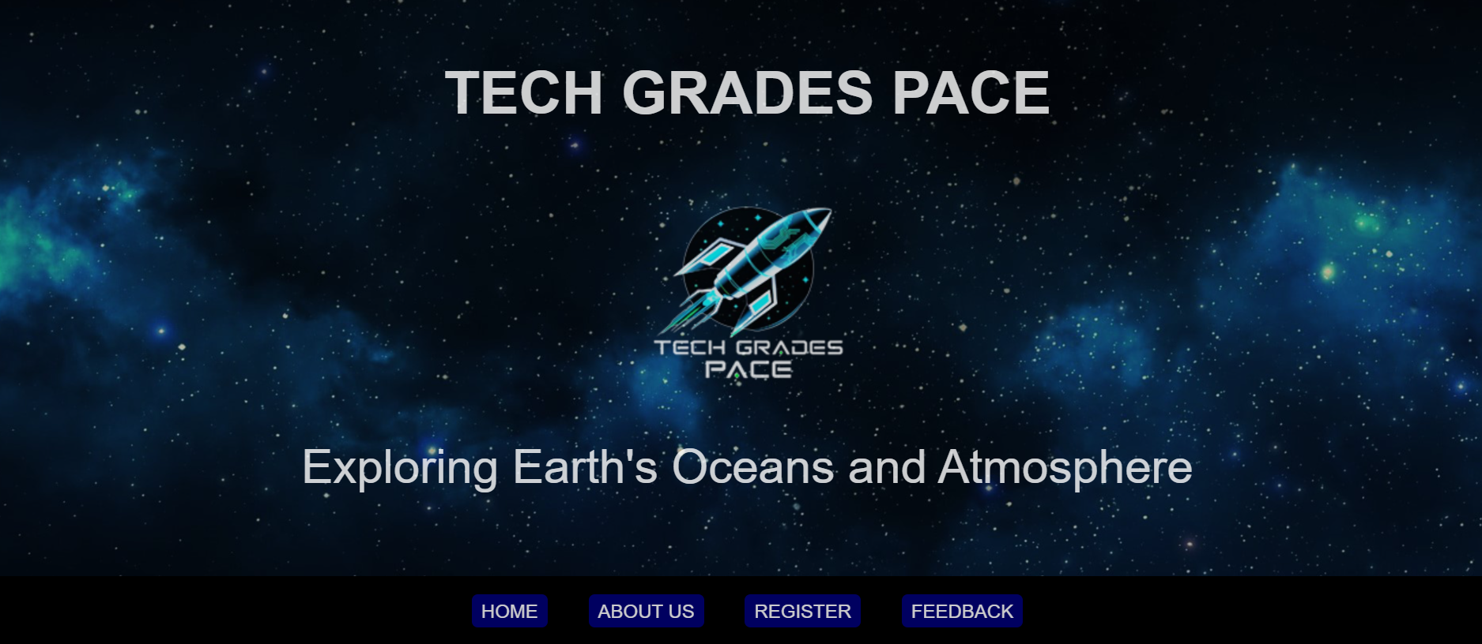
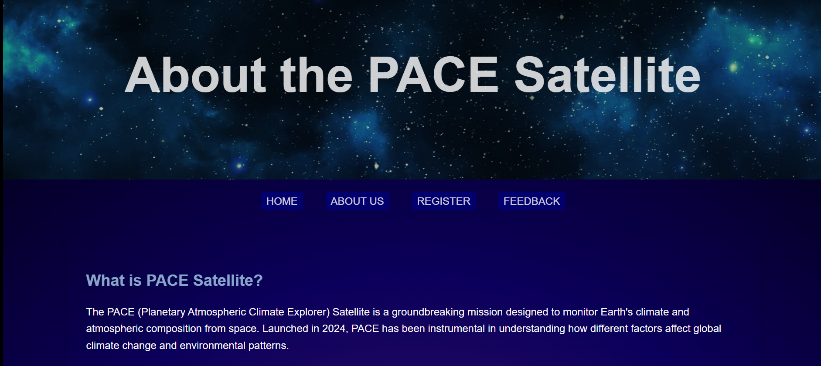
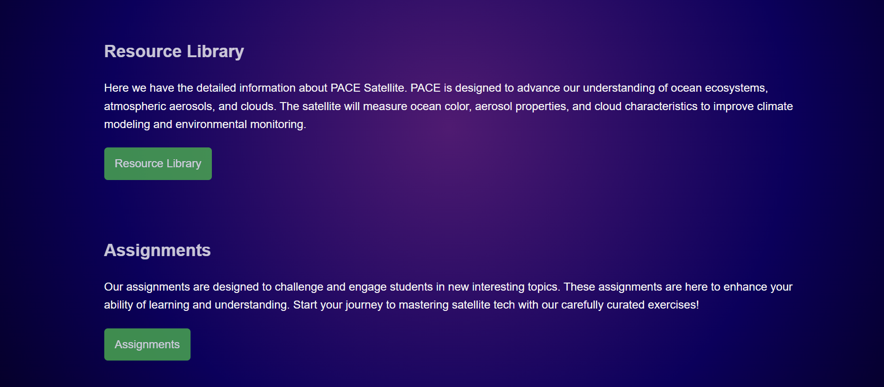
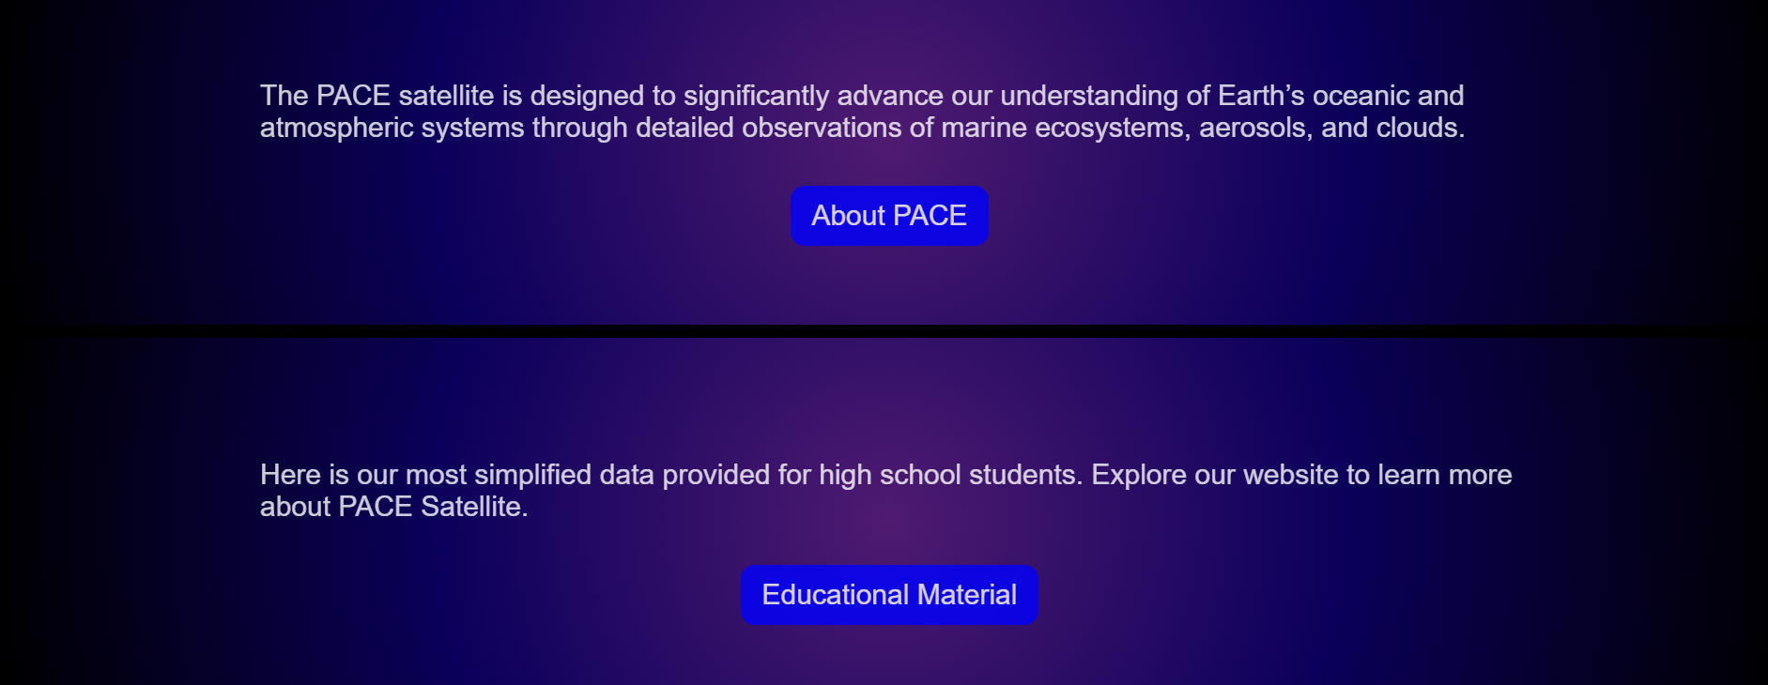
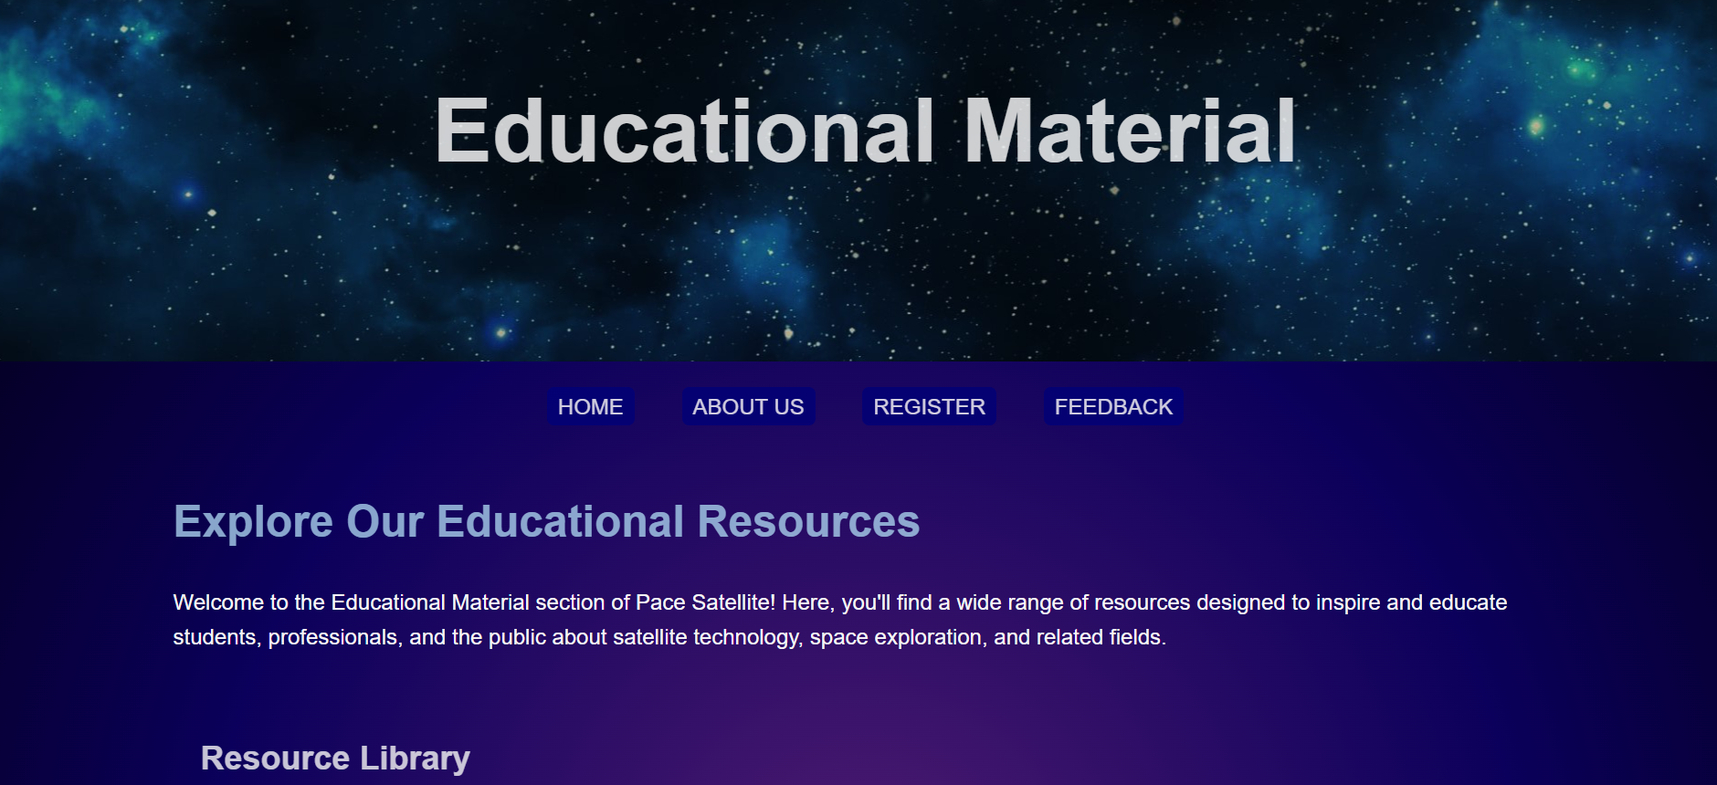
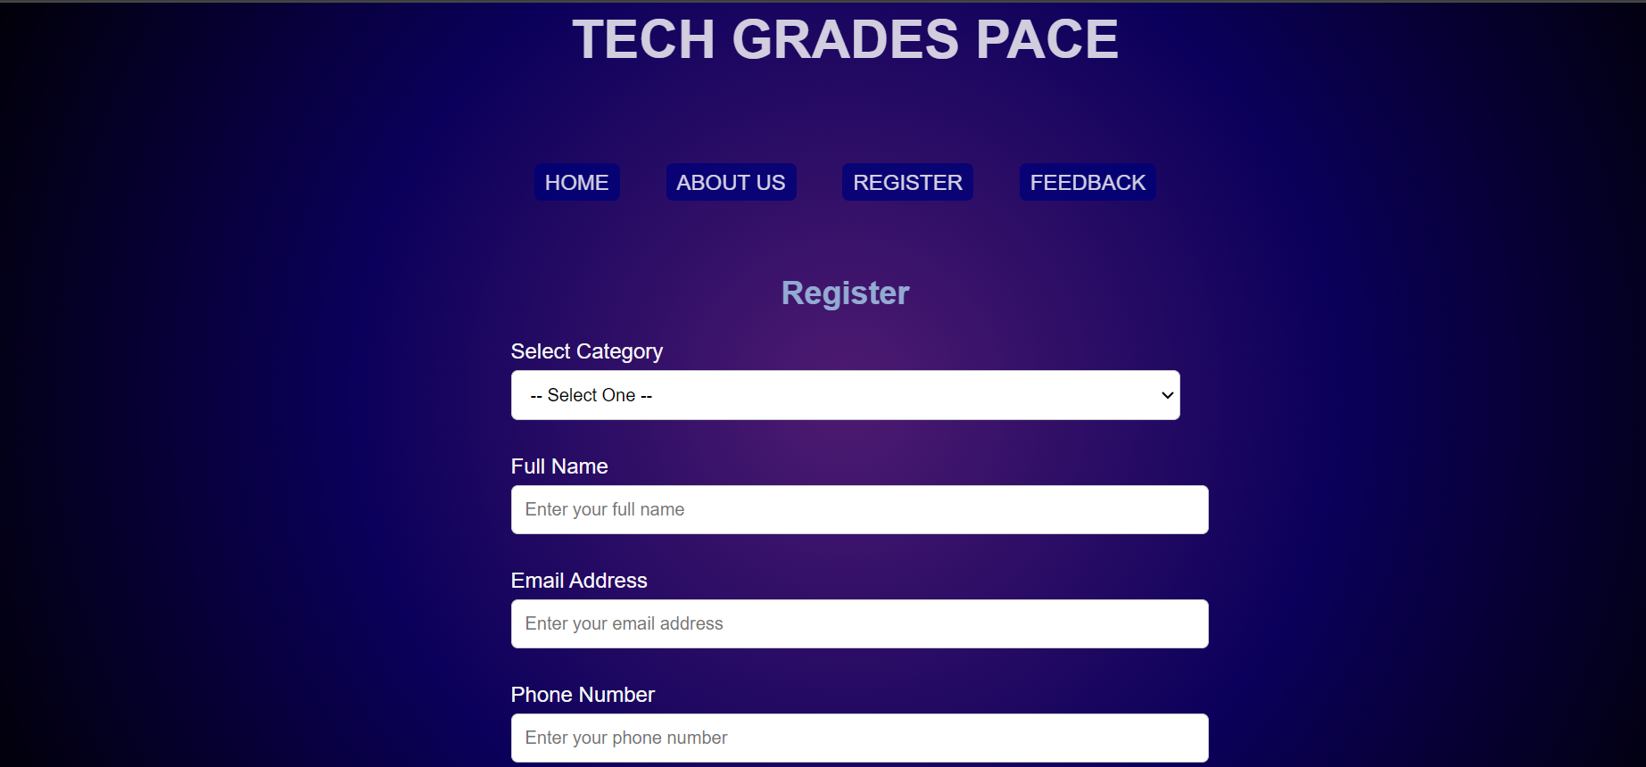
Snapshots of the prototype

Slide 10
for future devlopment :
Partnership with external projects.
Social media involvement for research.
Time to time security up gradation.
Direct students to teacher conversations will be their.

Slide 11
Provide links to your:
GitHub Public Repository:
https://github.com/bhaskar950880/TECH_GRADES.git
Demo Video Link (3 Minutes):
https://drive.google.com/drive/folders/1HwEu3Ik_S2YBCZ5TX_vg3uYUO8yTW6zY
Final Product Link:

Slide 12
Proof of Registration on https://www.spaceappschallenge.org/nasa-space-apps-2024/2024-local-events/noida
Add screenshots of your registered profile on the above mentioned link.
Screenshots to be added for all of the team members.

Slide 13


